Slide 1
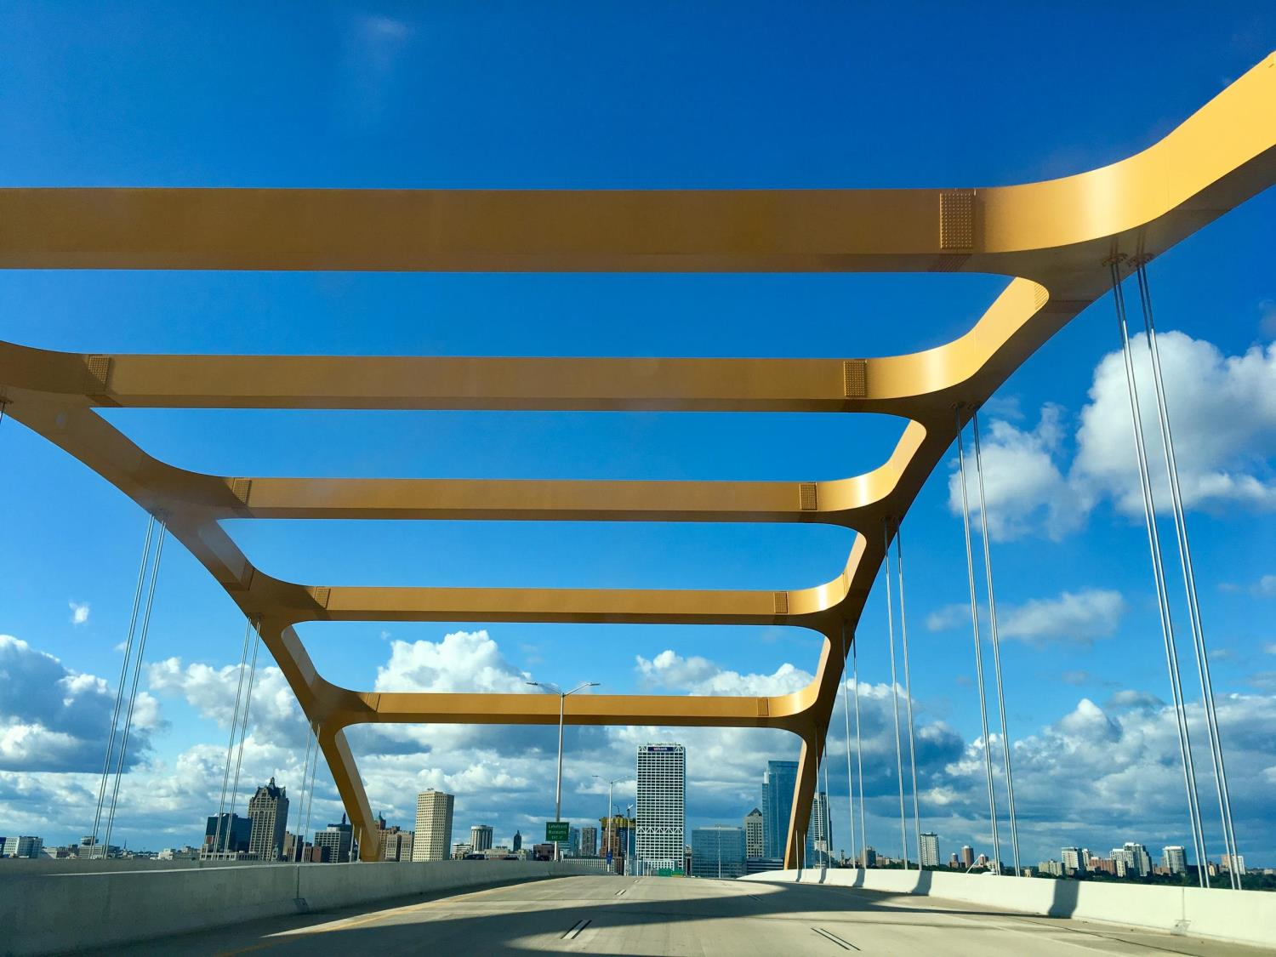
One Bridge
Bringing Business & Technology Together
Crowded House Innovators::
Awais Sultan, Stacie Kenney, Ziad Asim,
Shahid Afzal, Jason Gregory
Notes:
Note: This is the Hoan bridge, in Milwaukee, with the US Bank tower in the background ;-)

Slide 2
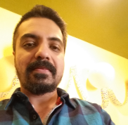
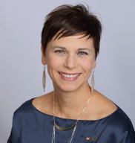
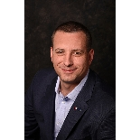
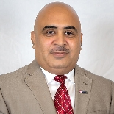
Crowded House Innovators
FOUNDER
Awais is a current BPM Architect for TOS and the brain child of this big idea. He is so good at delegating tasks, one might wonder if he does any actual work himself. Awais likes long walks on the beach and sharing coffee with friends.
CO-FOUNDER / TEAM MEMBER
Stacie works as a Business Process Analyst, helping business folks improve and automate their processes. She was brought into this madness by Awais and then recruited the rest of the team. Stacie likes big dogs and she cannot lie!
TEAM MEMBER
Jason is currently an SVP in Global Corporate Trust Services living the dream in the big apple. He’s our veteran business line guy on this team and is also a talented photographer. Jason like many New Yorkers is perpetually busy.
TEAM MEMBER
Ziad works with Stacie as a Business Process Analyst. He is super keen on massaging data into views that his business clients find valuable. Ziad also dotes on his wife and son, and enjoys spending time building his pipes at the local gym.
Note: Shahid Afzal is not pictured here, because he doesn’t have a picture on USBnet. He’s a super nice guy though!

Slide 3
PROBLEM / OPPORTUNITY
Most employees don’t know where to go with problems or ideas!
Problem:
The problem is that there is no one place for employees to go to when it comes to solving problems or issues, or exploring solution ideas.
Our survey synthesis shows that none of our participants referred to one place to go to, but instead they had several places based on their experiences, and most of them didn't even know where to start.
Opportunity:
The opportunity we see is to provide a one stop shop for problems and solution ideas, which may mean leveraging some of the existing tools already in place, and refining those or the processes around them.
Notes:
PROBLEM
Our survey and the resulting synthesis confirmed this hunch.
There was no ONE solution that people sought with their problems or ideas
Currently people are using whatever means they have based on their own experiences, that work well for them
OPPORTUNITY
We also know that there will need to be a lot of communication around the new solution, as well as an annual training element, so that all employees know about this solution and how to use it.

Slide 4
CUSTOMERS
Everyone; the problem doesn’t discriminate and neither does our solution
Primary = US Bank Business Line
Everyone has the problem of not really knowing where to go with an issue or solution idea.
The problem is costing the bank valuable resource time whereby instead of the employee doing their daily job, they’ve encountered a problem or idea and want to make their job more efficient or less problematic, so now they spend time looking for where to go.
Secondary = US Bank Customers
If the employees are not operating at their best, then they cannot deliver their best to our customers.
Notes:
- Even though TOS folks routinely support the implementation of solution ideas, they can also have ideas of their own to improve how they deliver, support, etc.
- They will ask their manager or someone else they know who might be able to point them in the right direction.
- They may submit a request via some BL specific process whereby it’s not managed well and therefore doesn’t provide timely responses.
- We know all of this based on our survey synthesis.

Slide 5


HUNCH
There are a few existing systems that do part of the job
We believe by creating a cohesive and collaborative solution, where the business and technology can come together, we can drive greater problem solving and implementation of ideas.
Essentially...
Creating – One Bridge (from Business to Technology)
Changing tough office work
… to kids play!

Slide 6
MARKET
Internal
This problem is worth solving, because it directly correlates to our strategy where we need to continually improve the way in which we work today.
We now also have Yammer and other workplace tools we didn’t have before, which can help us reach more employees than before.
We are not aware of any internal projects or efforts addressing this problem, but we do know that each business line has it’s own approach to maintaining their own procedures and process collateral.

Slide 7
MARKET
External
The team believes the toolset available at the bank currently is robust enough to satisfy the need at hand. Therefore, we don’t feel the need to expend effort to review external solutions at this time.

Slide 8





Current
Journey
SCENARIO:
Natalie has an idea about a business problem she would like to solve.
GOALS & EXPECTATIONS:
Natalie wants to share her idea with the right resources.
Natalie expects to easily find some place to share her idea.
Frustration sets in as she searches, and finds no logical place for her idea, since many options handle specific issues only.
Natalie asks around her team for answers, but finds none.
Natalie comes up with a great idea for improving the way her team works.
She’s not sure where to share this idea, so she starts with USBNet, and also asks around.
Natalie gives up and goes back to work.
1
4
2
5
3
Opportunity:
- Ideas and problems occur throughout the day.
Opportunity:
- Depending on where Natalie works, she can have many options to pursue.
Opportunity:
- Frustration can lead to job dissatisfaction.
Opportunity:
- When ideas cannot be easily shared then they are learned to be stifled and become missed opportunities.

Slide 9


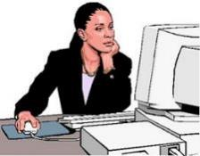
FUTURE
Journey
SCENARIO:
Natalie has an idea about a business problem she would like to solve.
GOALS & EXPECTATIONS:
Natalie wants to share her idea with the right resources.
Natalie expects to easily find some place to share her idea.
Natalie has a solution now where here idea can take flight.
The One Bridge site and problem or idea entry is easy and intuitive leaving Natalie feel satisfied.
A dedicated team reviews all the One Bridge entries and determines the best home for resolution, all while keeping Natalie updated on progress.
Natalie comes up with a great idea for improving the way her team works.
She has learned about One Bridge recently and goes there with her idea.
3
5
2
1
4
Value Proposition:
- Ideas and problems occur throughout the day. This is natural.
Value Proposition:
- Marketing for One Bridge will be multi channel and recurring.
Value Proposition:
- Feeling heard and being able to share ideas offers job satisfaction.
Value Proposition:
- Having a dedicated team with varied experiences working together is optimal.
Value Proposition:
- The feeling of winning in the workplace can be very empowering.

Slide 10








One Bridge - from Business to Technology The only place you need to go for turning ideas or problems into future possibilities.
Idea / Problem Home

Slide 11
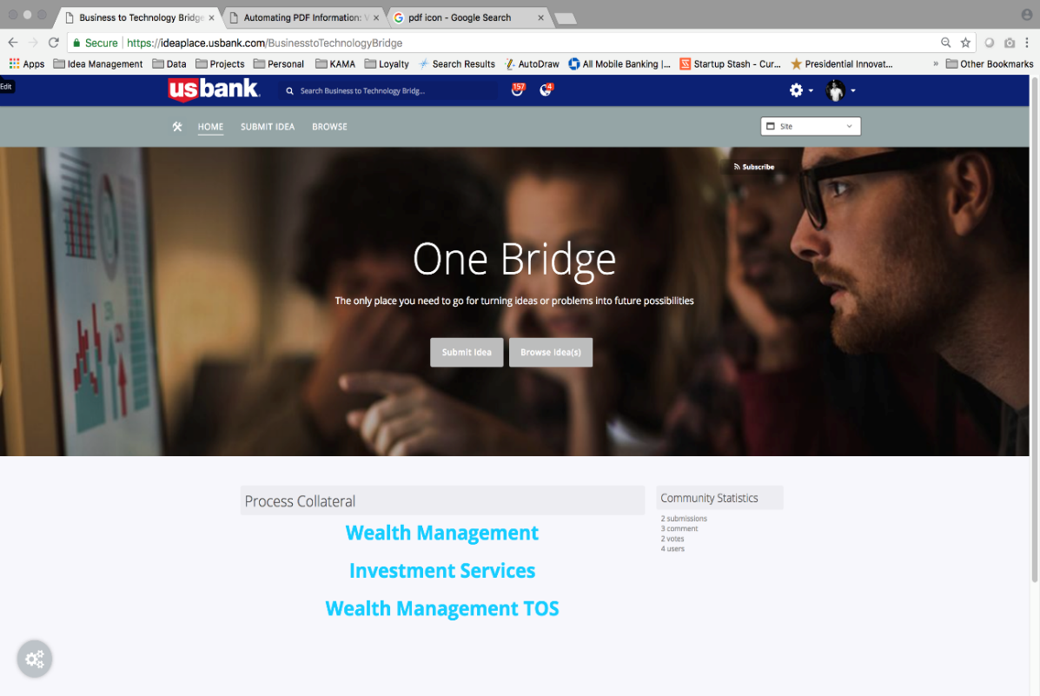
Leadership Buy in: US Bank initiative inviting business lines leadership to submit business issues.

Slide 12
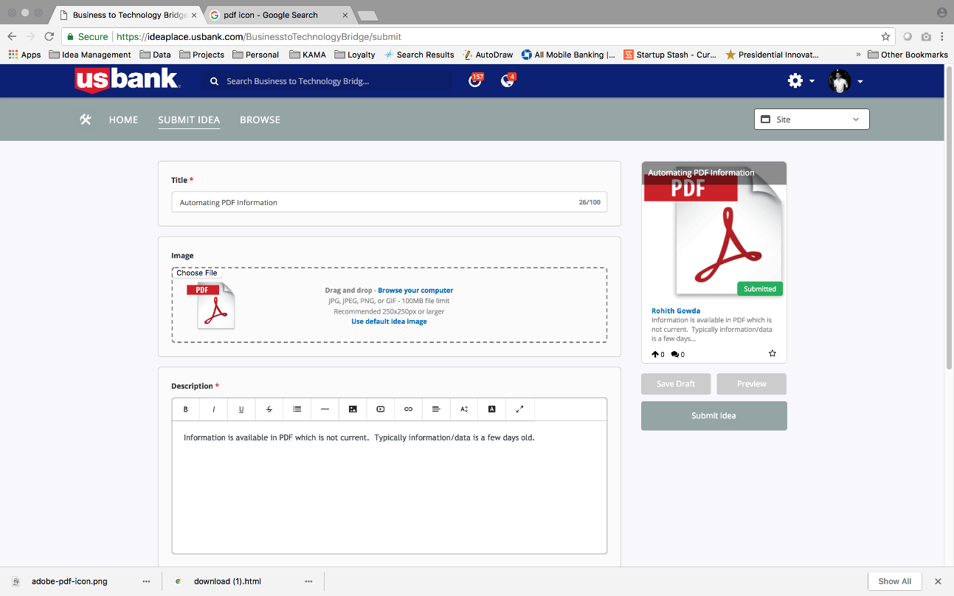
Submit Business Issue: Business issue description, attachments.

Slide 13
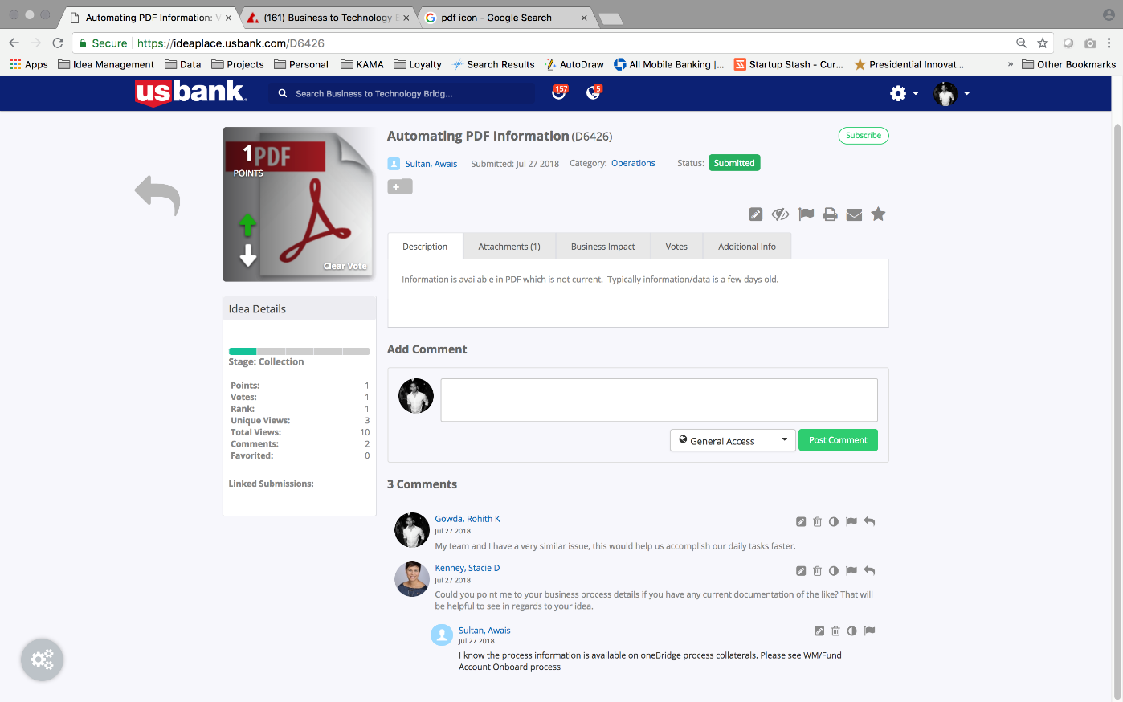
Collaboration: Collaboration on business issue between business users, COE, leadership.

Slide 14
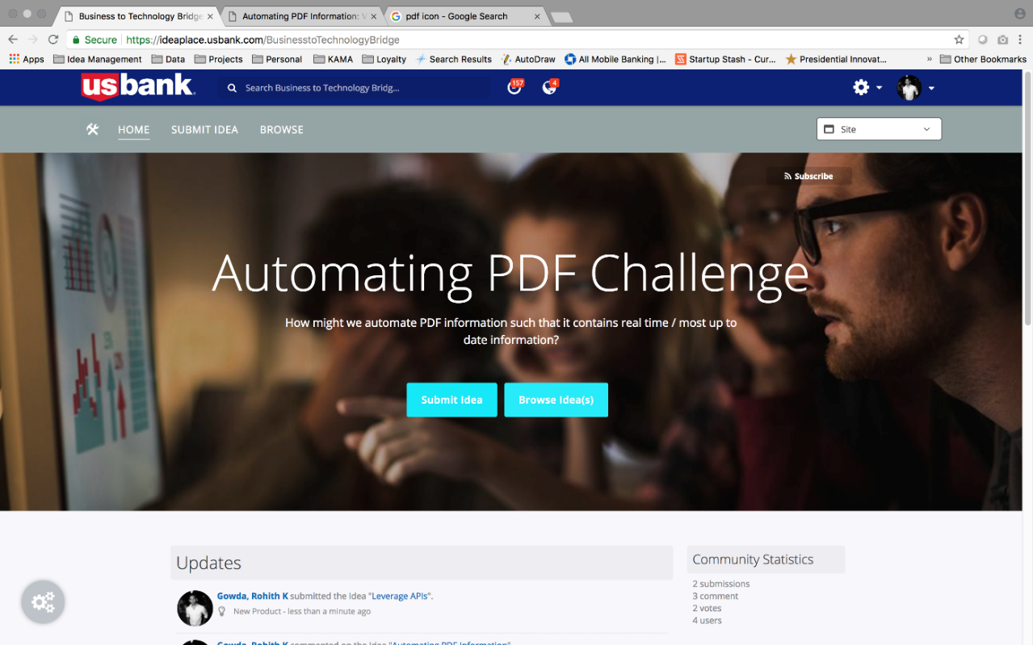
Move on to Ideation: Business issues will be posted as business Challenges in Ideaplace Or Bright Ideas Or CapEx committee can take over.

Slide 15
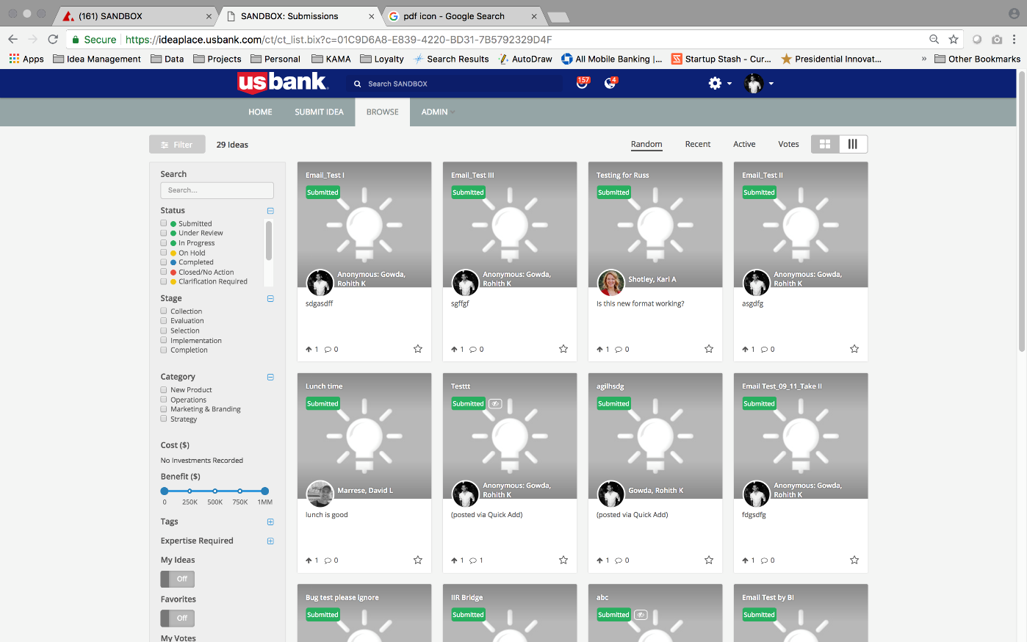
Ideas/Solutions for Business Challenge: Several ideas/ solutions can be posted by innovation groups/ TOS teams to solve business issue/challenge.

Slide 16
Value Propositions
Simplify your job. Increases Efficiency.
Streamlines process and Invites collaboration on business issues
Makes our job easier and simpler.
Better experience for our customers.
One Stop Shop for business processes information and to solve business issues
Powerful combo of domain expert and technical people.
One Bank
Improves Efficiency
Increases Revenue

Slide 17

NEXT STEPS
Future of Innovation. . .
Phase1
Exploit all resources to learn more about existing solutions (pros/cons to each)
Will partner with IdeaPlace and with functional prototype at hand will do more of primary research/interviews.
Focus on three business lines Wealth Management, Investment Services, WM TOS
Phase 2
Further improve the integration between One Bridge and other ideating tools.
Add other business lines to the platform.

Slide 18
Lessons Learned
We learned a lot through this awesome IIR journey.
Learned to always test our theory and hunch.
Improved experimentation/ interview techniques.
Met new people.
Learned great tools like IdeaPlace, Yammer, InVision.
Increased skillset through great workshops; Design Worskhop, Customer Empathy Map, Primary/Secondary Research, Journey Maps, Story Telling.
IIR is awesome.

Slide 19
Let’s collaborate. Thank you.
Questions

Slide 20
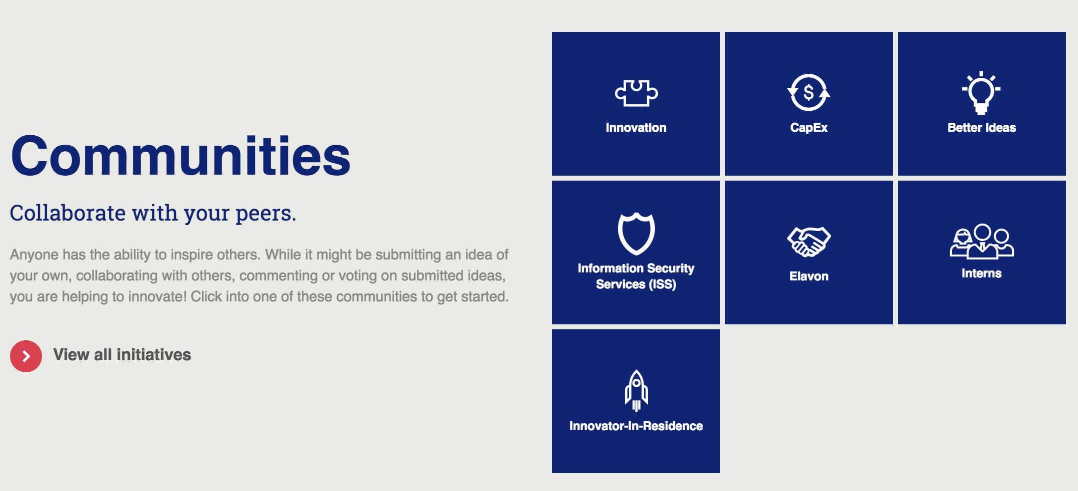
Appendix A -
[How this is different from IdeaPlace?]
[IdeaPlace is the platform, whereas OneBridge is the program. OneBridge will offer collaboration on business issues and will house business process information. OneBridge will gather business issues and improve connections with other tools so that problems move on seamlessly to ideation. Please see below an example of another program “Bright Ideas” using IdeaPlace as platform]

